Slide 1
Literacy Initiative

Slide 2
Predicting | August 17 – September 30 | Approximate # of days: 25
Summarizing (Fiction/Non) | October 1 – November 18 | Approximate# of days: 35
Connecting | November 19 – January 8 | Approximate# of days: 25
Questioning | January 11 – February 12 | Approximate # of days: 25
Inferring | February 15 – April 8 | Approximate # of days: 40
Strategy Streaming* | April 11 – April 29 | Approximate # of days: 15

Slide 3
Connecting Strategies in Social Studies

Slide 4
Strategy #1-Text to Text, Text to World, Text to Self
Focusing on text-to-self connections:
What does this story remind you of?
Can you relate to the characters in the story?
Does anything in this story remind you of anything in your own life?

Slide 5
Focusing on text-to-text connections:
What does this remind you of in another book you have read?
How is this text similar to other things you have read?
How is this text different from other things you have read?

Slide 6
Focusing on text-to-world connections:
What does this remind you of in the real world?
How are events in this story similar to things that happen in the real world?
How are events in this story different from things that happen in the real world?

Slide 7
Text
Reader
World
Text to Reader
World to Text
Reader to World

Slide 8
Strategy #2- Comparison Matrix

Slide 9
Questioning Strategies in Social Studies

Slide 10
Strategy #1: Questioning Web
In the middle of the “web” students ask a question and as they read they add details to help them answer the question.

Slide 11
Strategy #2: Questioning the Author
Sample Questions:
Initiating Queries (get a discussion started):
What do you think the author is attempting to say here?
Follow-up Queries (help students connect emerging meanings with their perceptions of author intention and with other ideas in the text):
Why do you think the author chose to use this phrase or wording in this specific spot?
Did the author explain this clearly?
Did the author tell us why?
Why do you think the author tells us this now?
Narrative Queries (help students think about character and craft):
How do things look for this character now?
How has the author let you know that something has changed?
How has the author settled this for us?

Slide 12
Example

Slide 13
Social Studies Example

Slide 14
Strategy #3- Questions Mailed To My Teacher
Students leave questions they had during the read or activity for their teacher in an envelope. Teachers can choose to respond to the questions many ways ex. Reading a question at the beginning of class or the end of class. Responding directly to the student on the same paper they wrote their question. Compile a list of questions from the students and create a research project or have the class try to answer as many as they can with a partner.
Dear Ms./Mr._______, Date: _____
_______________________________________________________________________________________________________________________________________________________________________________________________________________________________________________________________________________________________________
From: ________________________________
Class Period: __________

Slide 15
Strategy #4- Authentic Questions
Authentic or genuine questions are used to help all readers monitor their own comprehension of a reading selection.
STEPS:
1. Students read a selection and come up with questions they may have about: vocabulary, why a person did something, how a situation evolved or unfolded, what a paragraph was discussing, etc.
2. Students write down their questions on the following chart. This information could be used during a class discussion of the reading selection.

Slide 16
Strategy #5- Create Your Own QAR Questions
Directions: Students read a brief passage and create questions their own. Have students change papers with a classmate. They will answer each question and identify the evidence in the passage (unless it is an On My Own question) and explain their reasoning.
Types of QAR questions.
• Right There – questions that can be answered by simply locating the words in one sentence (literal comprehension)
• Think and Search – questions that can be found in the passage but not in one sentence (inferential comprehension)
• On My Own – questions that must be answered in the reader’s head (critical/creative comprehension).

Slide 17
Inferencing Strategies in Science, Social Studies, and Language Arts

Slide 18
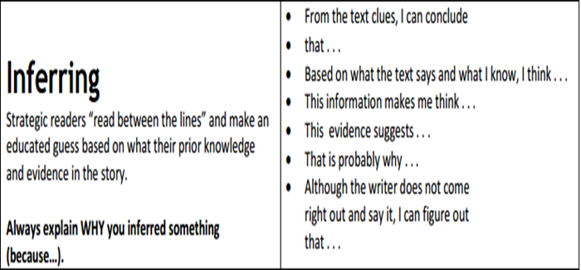
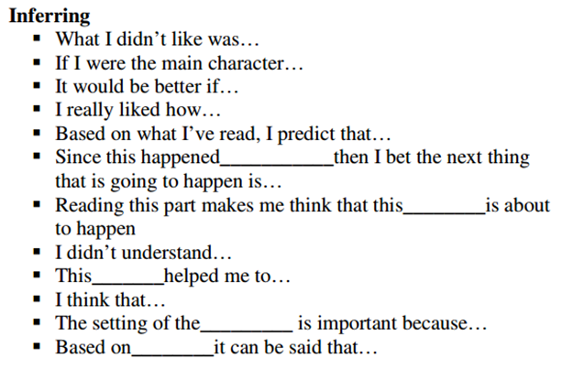
Strategy #1- Sentence Starters
Supply the students with the start to a sentence and have them complete it.

Slide 19
Strategy #2- Sequencing Text
Directions: Select paragraphs or excerpts from books that describe a sequence of events or activities. Activity ideas:
Place one of the sentences in the paragraph out of order, and ask the students to find the sentence that is scrambled and makes the reading confused. Direct students to correct the position of the sentence so that the sequence makes sense.
Cut up the sentences and have the students place them in the correct order.

Slide 20
Strategy #3 Cause/Effect Graphic Organizers
Causes signal words: reason, root, because, produced.
Effect signal words: brought about, effect, led to, outcome, produced, reaction, result, so, then, therefore.

Slide 21
Strategy #4- It Says, So I Say, So
Students consider questions linked to textual material, find information in the text that responds to the question, interpret the text using inference skills, and combine the information from the text and their own thinking to create an answer. The strategy encourages students to realize that when they create meaning, they combine their own ideas and thoughts with evidence and details that they find within a reading selection. The strategy works well with nonfiction and fiction texts.

Slide 23
Strategy #5- Vocabulary Mapping
Word maps and charts help students expand word meaning and discover relationships between vocabulary terms.

Slide 24
Social Studies Example

